Slide 1

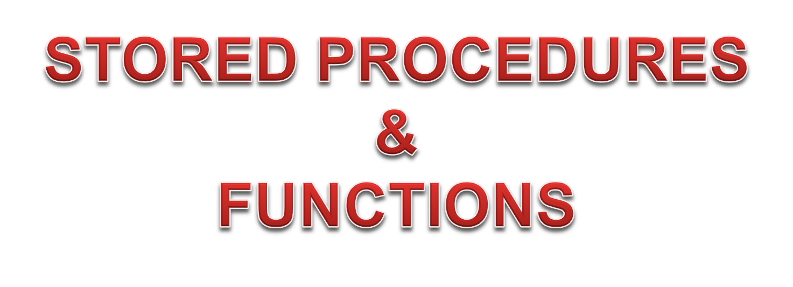

Slide 2
Introduction
In-order to understand sub programs and functions, we will start with understanding a Subprogram first.
What is a Subprogram?
  Subprograms are ‘Named PL/SQL blocks’ that can take parameters and be invoked.
Types of Subprogram: Two types are available in PL/SQL
  Procedures: generally used to perform action
  Functions: generally used to compute values

Slide 3
Advantages of using a Subprogram
Subprograms provide extensibility; that is, they let you tailor the PL/SQL language to suit your needs.
Subprograms also provide modularity; that is, they let you break a program down into manageable, well-defined modules that supports top-down design.
In addition, subprograms promote reusability and maintainability. Once validated, a subprogram can be used with confidence in any number of applications.

Slide 4
What is a Stored Procedure?
An independent program unit.
Stored in the data dictionary, after successful compilation
Designed to perform a specific task.
Can be executed by other applications that wish to accomplish that task.
Given a name so the other application will be able to reference the procedure when it is needed.
Can also be designed to accept information from the application invoking it and pass information back to that application.

Slide 5
Stored Procedures: Syntax
CREATE [OR REPLACE] PROCEDURE procedure_name ( parameters ) IS
Additional declaration of variables
BEGIN
executable statements
[ EXCEPTION
exception handlers ]
END [procedure_name];

Slide 6
Parameters
The parameters (or arguments) are optional. You don’t have to specify anything (not even the parenthesis).
Information that is passed between an application and a stored procedure is known as a parameter.
The process of invoking a stored procedure is often referred to as calling the procedure.

Slide 7
Stored Procedure: Simple Example
CREATE OR REPLACE PROCEDURE HELLO IS
BEGIN
DBMS_OUTPUT.PUT_LINE('Hello World');
END;
The above code declares a HELLO procedure that just displays ’Hello World’. You can run it as part of a code fragment, or inside other procedures (or functions).
Calling a Procedure:
BEGIN
HELLO();
END;
Execute it in SQL*Plus type:
CALL HELLO();

Slide 8
Stored Procedure: With Parameter
CREATE OR REPLACE
PROCEDURE DISPN (N NUMBER) IS
BEGIN
DBMS_OUTPUT.PUT_LINE(‘The number is : ’ || N);
END;
Calling the Procedure:
BEGIN
DISPN(12345);
END;
SQL> CALL DISPN(12345);
OUTPUT:-
The number is : 12345

Slide 9
Stored Procedure: With Parameters
CREATE OR REPLACE
PROCEDURE DISP_AB (A NUMBER, B NUMBER) IS
BEGIN
DBMS_OUTPUT.PUT_LINE(’A + B = ’ || (A + B));
DBMS_OUTPUT.PUT_LINE(’A * B = ’ || (A * B));
END;
Calling the Procedure:
BEGIN
DISP_AB(17,23);
END;
SQL> CALL DISP_AB(17, 23);
A + B = 40
A * B = 391

Slide 10
Procedure: Example Using The Employees Table
CREATE OR REPLACE PROCEDURE Employee_Info(empid NUMBER) IS
name1 VARCHAR2(35);
name2 VARCHAR2(35);
an_sal NUMBER;
BEGIN
SELECT first_name, last_name, salary * 12 INTO name1, name2, an_sal
FROM Employees WHERE emp_id = empid;
DBMS_OUTPUT.PUT_LINE(‘The name is: ‘ || RTRIM(name1) ||’ ‘ || RTRIM(name2));
IF an_sal > 180000 THEN
DBMS_OUTPUT.PUT_LINE(‘Please pay your tax in time. ‘);
ELSE
DBMS_OUTPUT.PUT_LINE(‘You need not pay tax this time! ’);
END IF;
EXCEPTION
WHEN no_data_found THEN
DBMS_OUTPUT.PUT_LINE(‘Not a valid employee’);
WHEN others THEN
DBMS_OUTPUT.PUT_LINE(‘ Some Other Error! ’);
END;

Slide 11
Stored Procedure: Accessing tables
CREATE OR REPLACE PROCEDURE Location_Info(loc_id NUMBER,
loc_name VARCHAR2) IS
BEGIN
INSERT INTO Location(locid, city)
VALUES(loc_id, loc_name);
DBMS_OUTPUT.PUT_LINE('Location Details Added.');
EXCEPTION
WHEN DUP_VAL_ON_INDEX THEN
DBMS_OUTPUT.PUT_LINE(‘Duplicate Location Code’);
WHEN others THEN
DBMS_OUTPUT.PUT_LINE(‘ Some Other Error! ’);
END;

Slide 12
Parameter Modes of a Procedure/Function
Input parameters (IN) are read-only values and cannot be changed within the function or stored procedure. This is the default option.
Output parameters (OUT) are designed to be sent back to the calling application. They are set to a null value when the procedure starts and must appear on the left side of an assignment statement.
An IN OUT parameter lets you pass initial values to the procedure and return updated values to the calling application.

Slide 13
Parameter Modes of a Procedure: Example
CREATE OR REPLACE PROCEDURE SUM_AB (A IN NUMBER, B NUMBER, C OUT NUMBER) IS
BEGIN
C := A + B;
END;
When we pass parameters via IN OUT, we can then first read the parameter, and then can later change it. For example, we can write a procedure that doubles a number:
--To call the procedure
DECLARE
R NUMBER;
BEGIN
SUM_AB(23,29,R);
DBMS_OUTPUT.PUT_LINE(’SUM IS: ’ || R);
END;
OUTPUT
SUM IS: 52

Slide 14
IN OUT Parameter Mode: Example
CREATE OR REPLACE PROCEDURE DOUBLEN (N IN OUT NUMBER) IS
BEGIN
N := N * 2;
END;
Notice that the above code does not display the resulting sum, it just changes the value of the C parameter. Also notice the word OUT right after the declaration of C parameter name.
--To call the procedure
DECLARE
R NUMBER;
BEGIN
R := 7;
DBMS_OUTPUT.PUT_LINE(’BEFORE CALL R IS: ’ || R);
DOUBLEN(R);
DBMS_OUTPUT.PUT_LINE(’AFTER CALL R IS: ’ || R);
END;
OUTPUT
BEFORE CALL R IS: 7
AFTER CALL R IS: 14

Slide 15
Replacing a Stored Procedure
If a procedure with a procedure name is created, you cannot create another procedure with the same name. In such a case, you need to use the DROP PROCEDURE command to remove the procedure and to create the procedure with the same procedure name.
However, an alternative to dropping and creating the procedure is to use the CREATE OR REPLACE PROCEDURE statement rather than the more basic CREATE PROCEDURE statement.
This would first DROP the procedure if it already exists and then CREATE a new procedure. If the procedure does not exist, the DROP is skipped and the CREATE is executed.

Slide 16
Dropping a Procedure
If you’re interested in getting rid of a procedure totally, you can DROP it. The general format of a DROP is:
DROP PROCEDURE procedure_name;

Slide 17
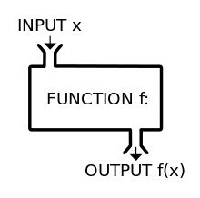

Slide 18
What is a Function?
Similar to a stored procedure except that it is designed to send a value back to the application that called the function.
Stored in the data dictionary, after successful compilation
Typically used by other programs to perform calculations and to obtain the results of those calculations.
Has a name and parameters that are passed between the function and the procedure that called the function.
Uses the RETURN keyword along with a data type to specify the type of data that will be returned from the function to the procedure that called the function.

Slide 19
Function: Syntax
CREATE [OR REPLACE] FUNCTION function_name ( parameters list ) RETURN DATATYPE IS
Additional declaration of variables
BEGIN
executable statements
[ EXCEPTION
exception handlers ]
END;

Slide 20
Function: Example
For example, to write a function that computes the sum of two numbers, you might do something like this:
CREATE OR REPLACE FUNCTION ADD_TWO (A NUMBER, B NUMBER) RETURN NUMBER IS
BEGIN
RETURN (A + B);
END;
--To call function
BEGIN
DBMS_OUTPUT.PUT_LINE(’RESULT IS: ’ || ADD_TWO(12,34));
END;
RESULT IS: 46

Slide 21
Function: Example
CREATE OR REPLACE FUNCTION FINDTOTAL() RETURN NUMBER IS
cnt NUMBER(3);
BEGIN
SELECT DISTINCT COUNT(*) INTO cnt FROM Employees;
RETURN cnt;
END;
--To call function
BEGIN
DBMS_OUTPUT.PUT_LINE(’NO OF EMPLOYEES IS: ’ || FINDTOTAL());
END;
NO OF EMPLOYEES IS: 4

Slide 22
Dropping a Function
If you’re interested in getting rid of a function totally, you can DROP it. The general format of a DROP is:
DROP FUNCTION function_name;

Slide 23
Procedure versus Function
Here are a few more differences between a procedure and a function:
A function MUST return a value
A procedure cannot return a value
Procedures and functions can both return data in OUT and IN OUT parameters
The return statement in a function returns control to the calling program and returns the results of the function
The return statement of a procedure returns control to the calling program and cannot return a value
Functions can be called from SQL, procedure cannot
Functions are considered expressions, procedure are not.

Slide 24
How to work with Subprograms?
Write a function/procedure separately from the calling program.
Thus, function, procedure & call are to be stored in separate files.
The function/procedure must be compiled(F5) separately without errors and then call can be made
If errors are there, use command
SHOW ERRORS FUNCTION function_name; OR
SHOW ERRORS PROCEDURE procedure_name;

Slide 25
WorkSheet 5
Create and test a procedure to display the employees residing in ‘Shillong’. For the above problem, use an explicit cursor in a stored procedure to show the employee details.
Create and test a function to return the total number of employees residing in a particular city passed as parameter..
Create a stored procedure to allow insertion of records for the employees table. Call the procedure to actually insert a record for an employee. In the exception block, handle the error for primary key column so that its value is not duplicated.
Create a function to return the maximum, minimum, sum, and average of salaries of all employees. Call the function from a PL/SQL program to display a formatted well-designed result.
Create and test a stored procedure that accepts a department name as an input parameter. In the executable section, perform a select on the Departments table to check whether such a department exists or not. Display appropriate message for the output.
Create and test a stored procedure to display those employee names whose first name or last name starts with ‘S’.

